Slide 1
Ensemble Learning
Lectured by Shangsong Liang
Sun Yat-sen University
Notes:
Jing Gao, Wei Fan, Jiawei Han. Some Slides and references available at http://ews.uiuc.edu/~jinggao3/sdm10ensemble.htm

Slide 2
Outline
An overview of ensemble methods
  Motivations
  Overview
Supervised ensemble
Unsupervised ensemble
Semi-supervised ensemble
  Multi-view learning
  Consensus maximization among supervised and unsupervised models
Applications
  Transfer learning, stream classification, anomaly detection

Slide 3

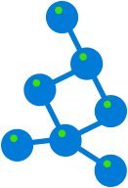
Ensemble
model 1
Ensemble model
Data
model 2
……
Combine multiple models into one!
model k
Applications: classification, clustering, collaborative filtering, anomaly detection……

Slide 4
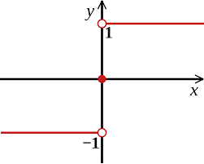
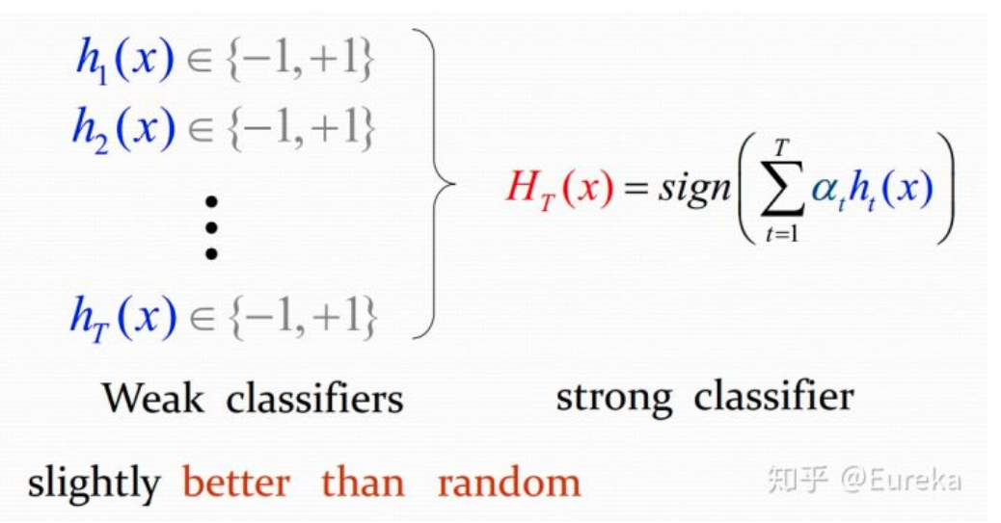

Example: Ensemble for Classification

Slide 5
How to get weak classifiers?
Different weak classifiers as base classifiers.
2. The same weak classifier, but different parameters.
3. Using different subset of features/dimensions of the training data.
4. Different subset of training data: bagging (such as boostrap aggregating), and boosting

Slide 6
How to combine weak classifiers?
Multiple experts: Parallel architecture. Vote for the final decisions.
Cascade connection: The next base classifier can only make decision based on the output of the previous base classifier. E.g., cascading ensemble learning.

Slide 7



Stories of Success
Million-dollar prize
  Improve the baseline movie recommendation approach of Netflix by 10% in accuracy
  The top submissions all combine several teams and algorithms as an ensemble
Data mining competitions
  Classification problems
  Winning teams employ an ensemble of classifiers

Slide 8
Netflix Prize
Supervised learning task
  Training data is a set of users and ratings (1,2,3,4,5 stars) those users have given to movies.
  Construct a classifier that given a user and an unrated movie, correctly classifies that movie as either 1, 2, 3, 4, or 5 stars
  $1 million prize for a 10% improvement over Netflix’s current movie recommender
Competition
  At first, single-model methods are developed, and performances are improved
  However, improvements slowed down
  Later, individuals and teams merged their results, and significant improvements are observed

Slide 9
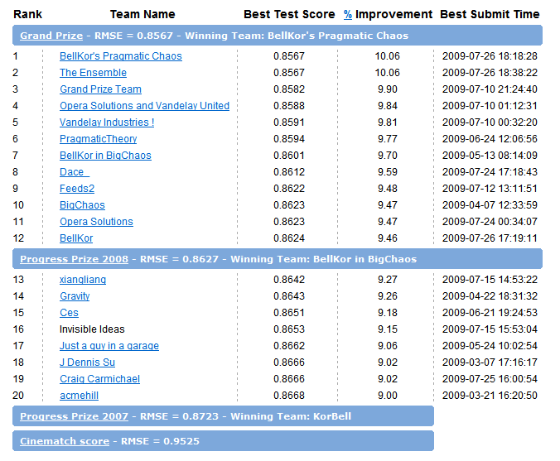
Leaderboard
“A good solution (RMSE=0.8712) consists of blending 107 individual results. “
“Predictive accuracy is substantially improved when blending multiple predictors. Our experience is that most efforts should be concentrated in deriving substantially different approaches, rather than refining a single technique. ”

Slide 10
Motivations
Motivations of ensemble methods
  Ensemble model improves accuracy and robustness over single model methods
  Applications:
    distributed computing
    privacy-preserving applications
    large-scale data with reusable models
    multiple sources of data
  Efficiency: a complex problem can be decomposed into multiple sub-problems that are easier to understand and solve (divide-and-conquer approach)

Slide 11
Relationship with Related Studies (1)
Multi-task learning
  Learn multiple tasks simultaneously
  Ensemble methods: use multiple models to learn one task
Data integration
  Integrate raw data
  Ensemble methods: integrate information at the model level

Slide 12
Relationship with Related Studies (2)
Meta learning
  Learn on meta-data (include base model output)
  Ensemble methods: besides learn a joint model based on model output, we can also combine the output by consensus
Non-redundant clustering
  Give multiple non-redundant clustering solutions to users
  Ensemble methods: give one solution to users which represents the consensus among all the base models

Slide 13
Why Ensemble Works? (1)
Intuition
  Combining diverse, independent opinions in human decision-making as a protective mechanism (e.g. stock portfolio)
Uncorrelated error reduction
  Suppose we have 5 completely independent classifiers for majority voting
  If accuracy is 70% for each
    10 (.7^3)(.3^2)+5(.7^4)(.3)+(.7^5)
    83.7% majority vote accuracy
  101 such classifiers
    99.9% majority vote accuracy
from T. Holloway, Introduction to Ensemble Learning, 2007.

Slide 14
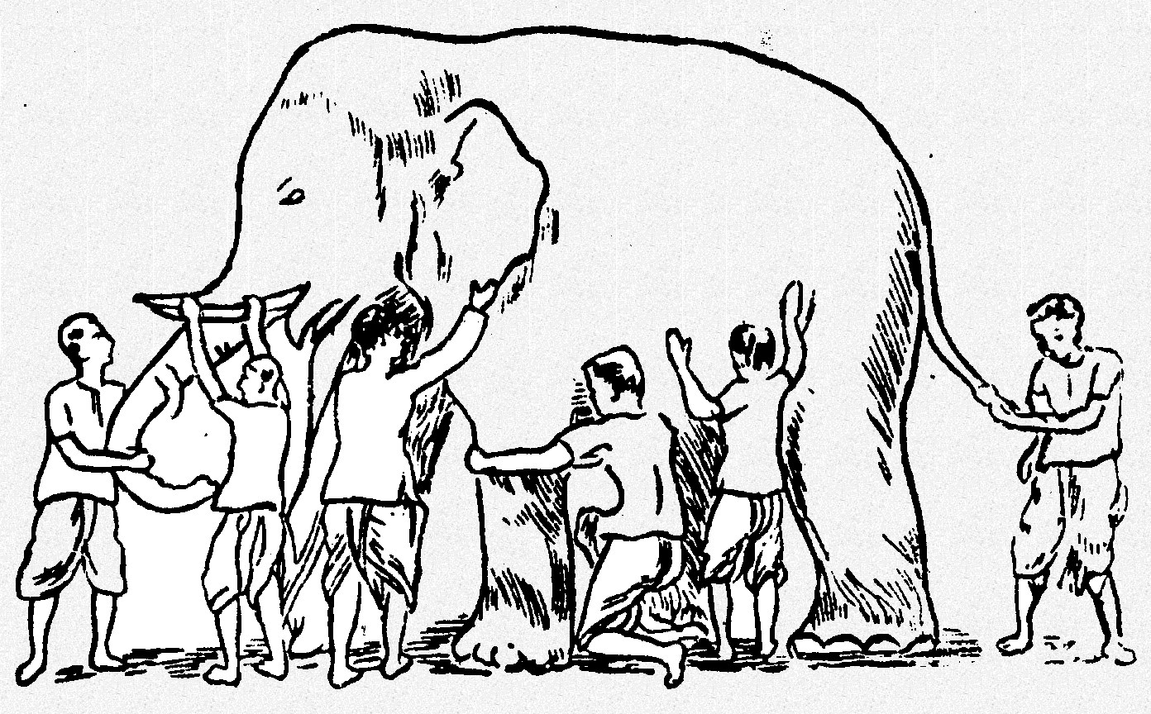
Why Ensemble Works? (2)
Some unknown distribution
Model 1
Model 6
Model 3
Model 5
Model 2
Model 4
Ensemble gives the global picture!

Slide 15
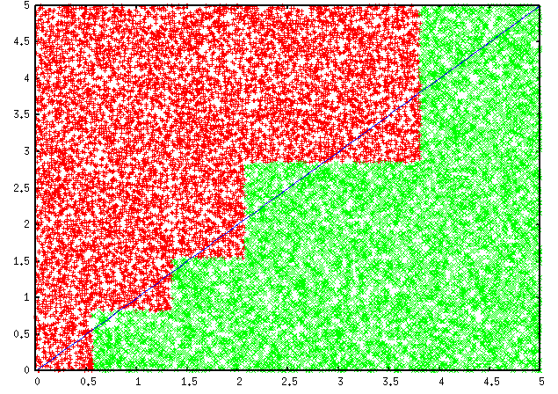
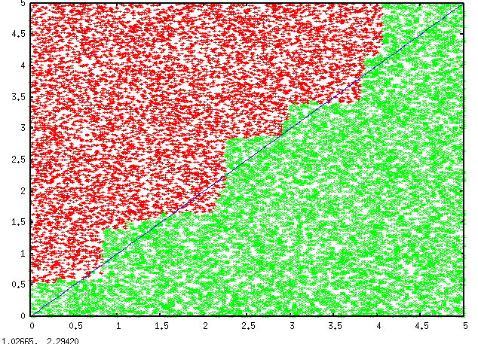
Why Ensemble Works? (3)
Overcome limitations of single hypothesis
  The target function may not be implementable with individual classifiers, but may be approximated by model averaging
Decision Tree
Model Averaging

Slide 16
Research Focus
Base models
  Improve diversity!
Combination scheme
  Consensus (unsupervised)
  Learn to combine (supervised)
Tasks
  Classification (supervised or semi-supervised ensemble )
  Clustering (unsupervised ensemble)

Slide 17
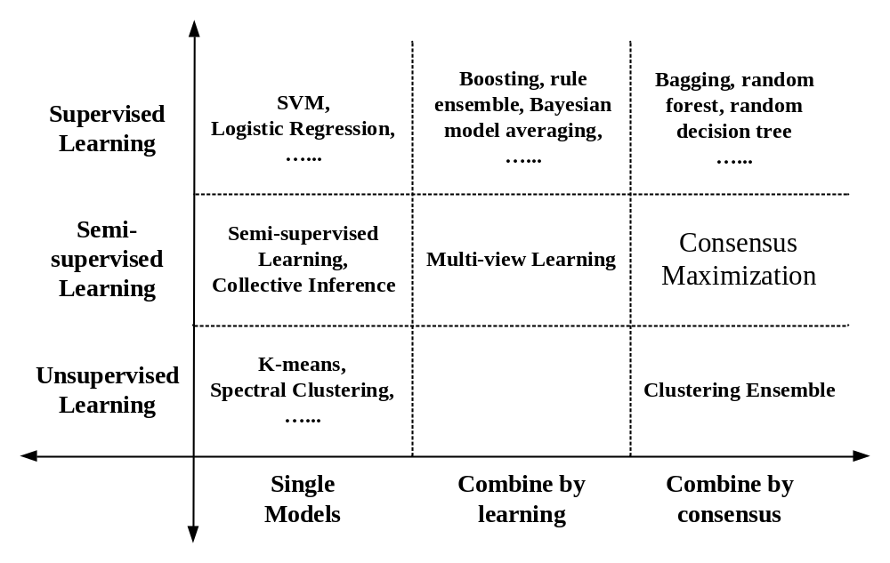
Summary
Review the ensemble methods in the tutorial

Slide 18
Ensemble of Classifiers—Learn to Combine
training
test
classifier 1
Ensemble model
labeled
data
unlabeled
data
classifier 2
……
classifier k
final
predictions
learn the combination from labeled data
Algorithms: boosting, stacked generalization, rule ensemble, Bayesian model averaging……

Slide 19
Ensemble of Classifiers—Consensus
training
test
classifier 1
unlabeled
data
combine the predictions by majority voting
labeled
data
classifier 2
……
classifier k
final
predictions
Algorithms: bagging, random forest, random decision tree, model averaging of probabilities……

Slide 20
Clustering Ensemble—Consensus
clustering algorithm 1
clustering algorithm 2
unlabeled
data
combine the partitionings by consensus
……
……
clustering algorithm k
final
clustering
Algorithms: direct approach, object-based, cluster-based, object-cluster-based approaches, generative models

Slide 21
Semi-Supervised Ensemble—Learn to Combine
training
test
classifier 1
Ensemble model
labeled
data
unlabeled
data
classifier 2
……
classifier k
final
predictions
learn the combination from both labeled and unlabeled data
Algorithms: multi-view learning

Slide 22
Semi-supervised Ensemble—Consensus
classifier 1
labeled
data
classifier 2
……
unlabeled
data
combine all the supervised and unsupervised results by consensus
classifier k
clustering 1
final
predictions
clustering 2
……
……
clustering h
Algorithms: consensus maximization

Slide 23
Pros and Cons
 | Combine by learning | Combine by consensus
Pros | Get useful feedbacks from labeled data Can potentially improve accuracy | Do not need labeled data Can improve the generalization performance
Cons | Need to keep the labeled data to train the ensemble May overfit the labeled data Cannot work when no labels are available | No feedbacks from the labeled data Require the assumption that consensus is better

Slide 24
Outline
An overview of ensemble methods
  Motivations
  Tutorial overview
Supervised ensemble
Unsupervised ensemble
Semi-supervised ensemble
  Multi-view learning
  Consensus maximization among supervised and unsupervised models
Applications
  Transfer learning, stream classification, anomaly detection

Slide 25
Supervised Ensemble Methods
Problem
  Given a data set D={x₁,x₂,…,x_{n}} and their corresponding labels L={l₁,l₂,…,l_{n}}
  An ensemble approach computes:
    A set of classifiers {f₁,f₂,…,f_{k}}, each of which maps data to a class label: f_{j}(x)=l
    A combination of classifiers f* which minimizes generalization error: f*(x)= w₁f₁(x)+ w₂f₂(x)+…+ w_{k}f_{k}(x)

Slide 26
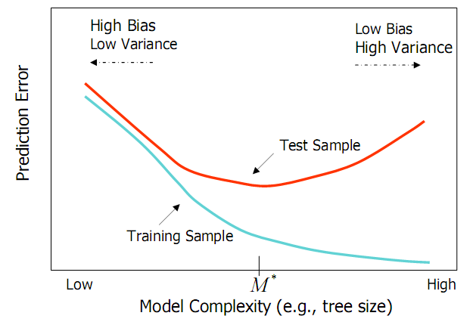
Bias and Variance
Ensemble methods
  Combine learners to reduce variance
from Elder, John. From Trees to Forests and Rule Sets - A Unified Overview of Ensemble Methods. 2007.

Slide 27
Generating Base Classifiers
Sampling training examples
  Train k classifiers on k subsets drawn from the training set
Using different learning models
  Use all the training examples, but apply different learning algorithms
Sampling features
  Train k classifiers on k subsets of features drawn from the feature space
Learning “randomly”
  Introduce randomness into learning procedures

Slide 28
Bagging* (1)
Bootstrap
  Sampling with replacement
  Contains around 63.2% original records in each sample
Bootstrap Aggregation
  Train a classifier on each bootstrap sample
  Use majority voting to determine the class label of ensemble classifier
*[Breiman96]

Slide 29
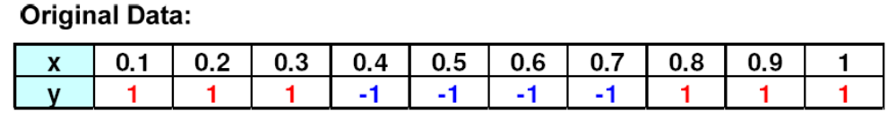
Bagging (2)
Bootstrap samples and classifiers:
Combine predictions by majority voting
from P. Tan et al. Introduction to Data Mining.
Notes:
Bagging算法（英语：Bootstrap aggregating，引导聚集算法），又称装袋算法，是机器学习领域的一种团体学习算法。最初由Leo Breiman于1996年提出。Bagging 算法又称引导聚合算法，是一种集成学习算法，通常用于降低噪声数据集中的方差。 在Bagging 方法中，用替换法来选择训练集中的随机数据样本，这意味着可多次选择单个数据点。 在生成多个数据样本后，将单独训练这些弱模型，根据任务类型（如回归或分类），这些预测的平均值或多数值会产生更准确的估计值。

Slide 30

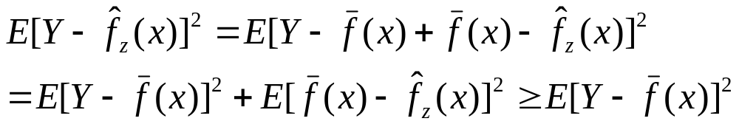
Bagging (3)
Error Reduction
  Under mean squared error, bagging reduces variance and leaves bias unchanged
  Consider idealized bagging estimator:
  The error is
  Bagging usually decreases MSE
from Elder, John. From Trees to Forests and Rule Sets - A Unified Overview of Ensemble Methods. 2007.

Slide 31
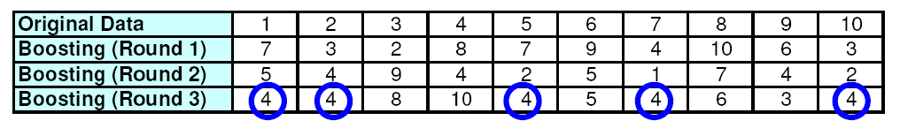
Boosting* (1)
Principles
  Boost a set of weak learners to a strong learner
  Make records currently misclassified more important
Example
  Record 4 is hard to classify
  Its weight is increased, therefore it is more likely to be chosen again in subsequent rounds
*[FrSc97]
from P. Tan et al. Introduction to Data Mining.

Slide 32
Boosting (2)
AdaBoost
  Initially, set uniform weights on all the records
  At each round
    Create a bootstrap sample based on the weights
    Train a classifier on the sample and apply it on the original training set
    Records that are wrongly classified will have their weights increased
    Records that are classified correctly will have their weights decreased
    If the error rate is higher than 50%, start over
  Final prediction is weighted average of all the classifiers with weight representing the training accuracy

Slide 33
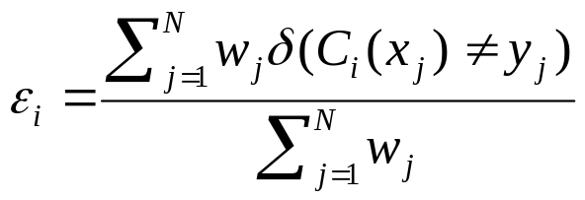
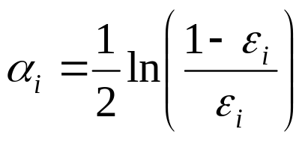
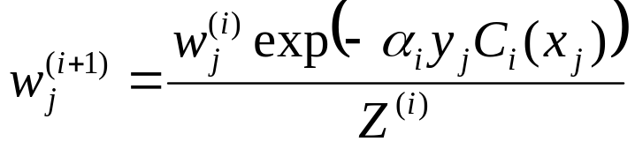
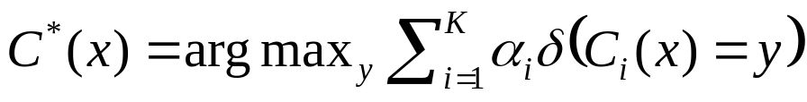
Boosting (3)
Determine the weight
  For classifier i, its error is
  The classifier’s importance is represented as:
  The weight of each record is updated as:
  Final combination:

Slide 34
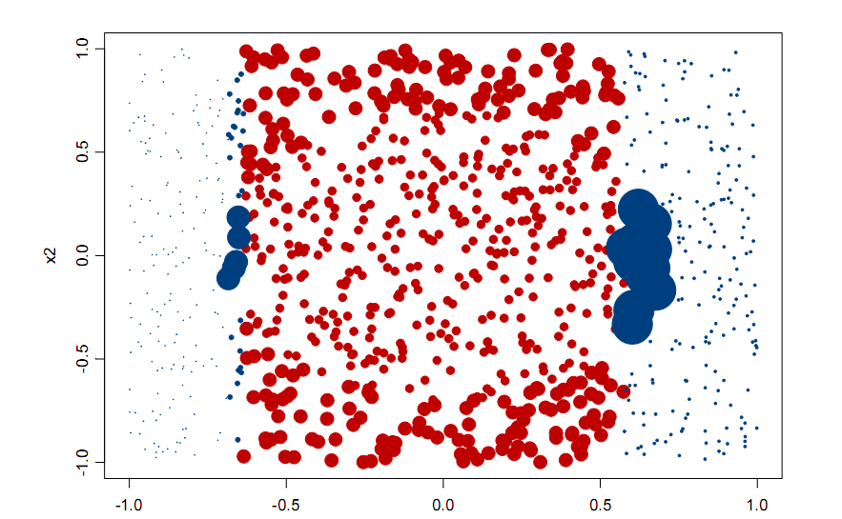
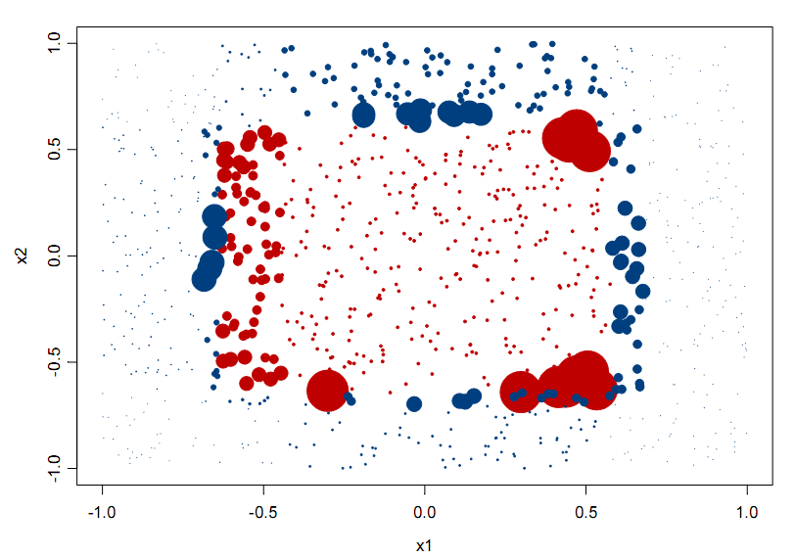
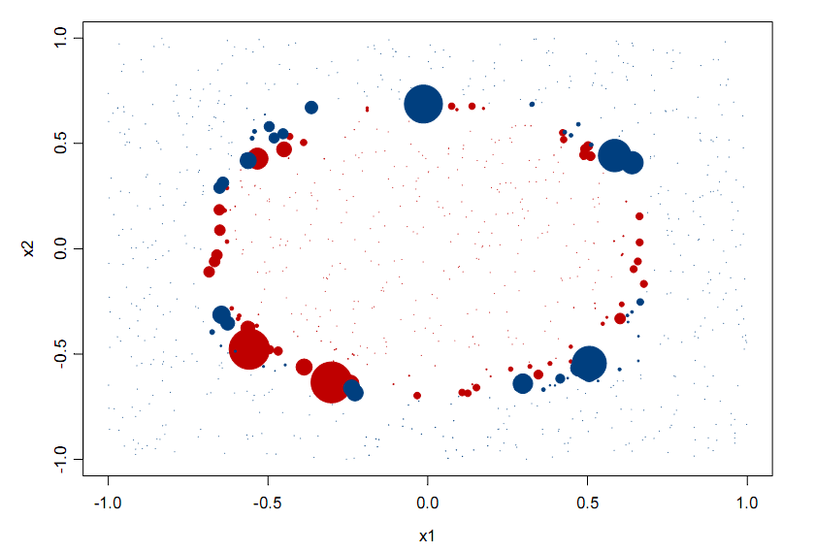
Classifications (colors) and
Weights (size) after 1 iteration
Of AdaBoost
20 iterations
3 iterations
from Elder, John. From Trees to Forests and Rule Sets - A Unified Overview of Ensemble Methods. 2007.
Notes:
Note after 1 iteration the step classes of a single decision tree.

Slide 35
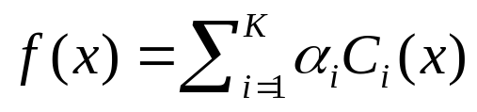
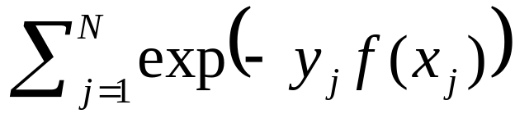
Boosting (4)
Explanation
  Among the classifiers of the form:
  We seek to minimize the exponential loss function:
  Not robust in noisy settings

Slide 36
Random Forests* (1)
Algorithm
  Choose T—number of trees to grow
  Choose m<M (M is the number of total features) —number of features used to calculate the best split at each node (typically 20%)
  For each tree
    Choose a training set by choosing N times (N is the number of training examples) with replacement from the training set
    For each node, randomly choose m features and calculate the best split
    Fully grown and not pruned
  Use majority voting among all the trees
*[Breiman01]

Slide 37
Random Forests (2)
Discussions
  Bagging+random features
  Improve accuracy
    Incorporate more diversity and reduce variances
  Improve efficiency
    Searching among subsets of features is much faster than searching among the complete set

Slide 38
Random Decision Tree* (1)
Single-model learning algorithms
  Fix structure of the model, minimize some form of errors, or maximize data likelihood (eg., Logistic regression, Naive Bayes, etc.)
  Use some “free-form” functions to match the data given some “preference criteria” such as information gain, gini index and MDL. (eg., Decision Tree, Rule-based Classifiers, etc.)
Such methods will make mistakes if
  Data is insufficient
  Structure of the model or the preference criteria is inappropriate for the problem
Learning as Encoding
  Make no assumption about the true model, neither parametric form nor free form
  Do not prefer one base model over the other, just average them
*[FWM+03]

Slide 39
Random Decision Tree (2)
Algorithm
  At each node, an un-used feature is chosen randomly
    A discrete feature is un-used if it has never been chosen previously on a given decision path starting from the root to the current node.
    A continuous feature can be chosen multiple times on the same decision path, but each time a different threshold value is chosen
  We stop when one of the following happens:
    A node becomes too small (<= 3 examples).
    Or the total height of the tree exceeds some limits, such as the total number of features.
  Prediction
    Simple averaging over multiple trees

Slide 40
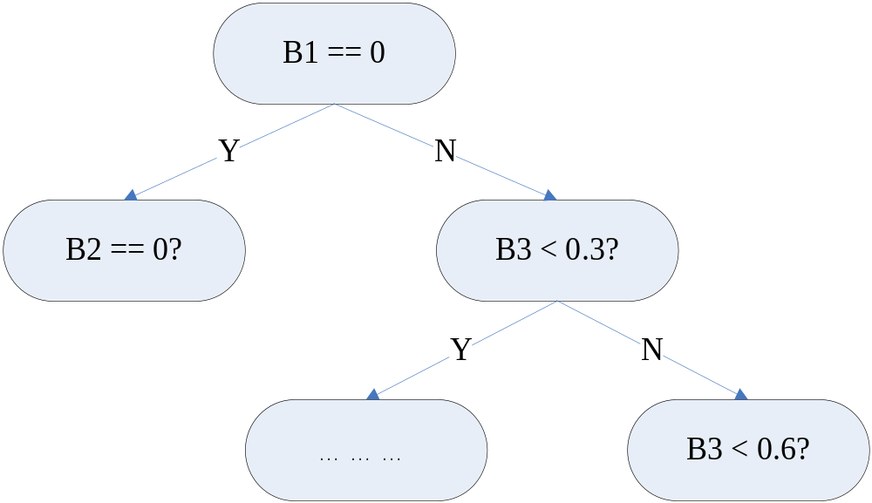
Random Decision Tree (3)
B1: {0,1}
B2: {0,1}
B3: continuous
B1 chosen randomly
Random threshold 0.3
B2: {0,1}
B3: continuous
B2: {0,1}
B3: continuous
B3 chosen randomly
B2 chosen randomly
Random threshold 0.6
B3: continous

Slide 41
Random Decision Tree (4)
Potential Advantages
  Training can be very efficient. Particularly true for very large datasets.
    No cross-validation based estimation of parameters for some parametric methods.
  Natural multi-class probability.
  Imposes very little about the structures of the model.

Slide 42
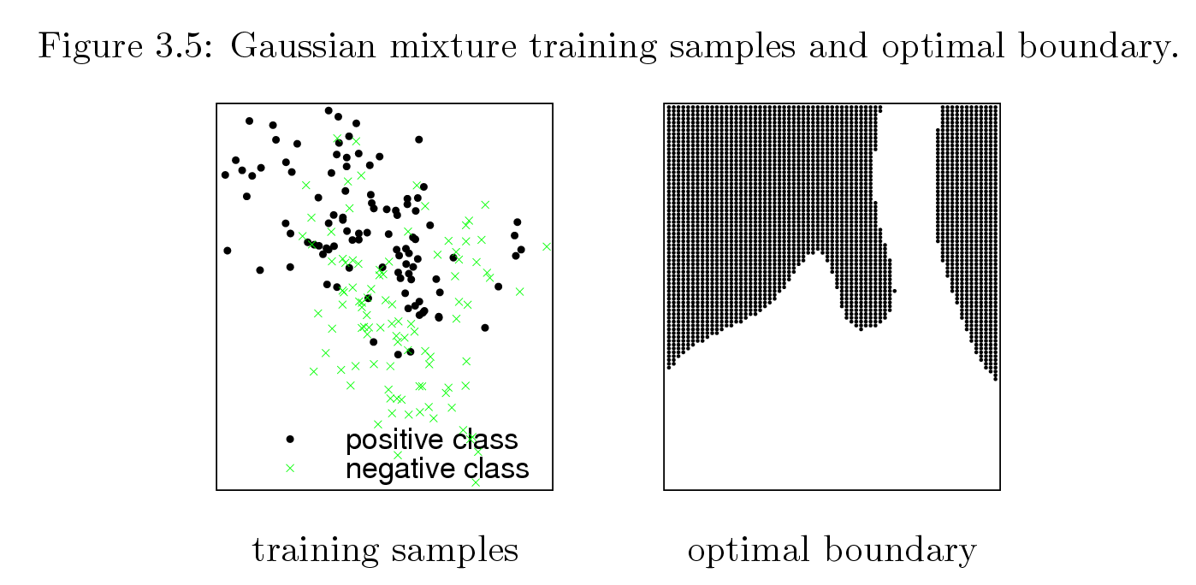
Optimal Decision Boundary
from Tony Liu’s thesis (supervised by Kai Ming Ting)

Slide 43
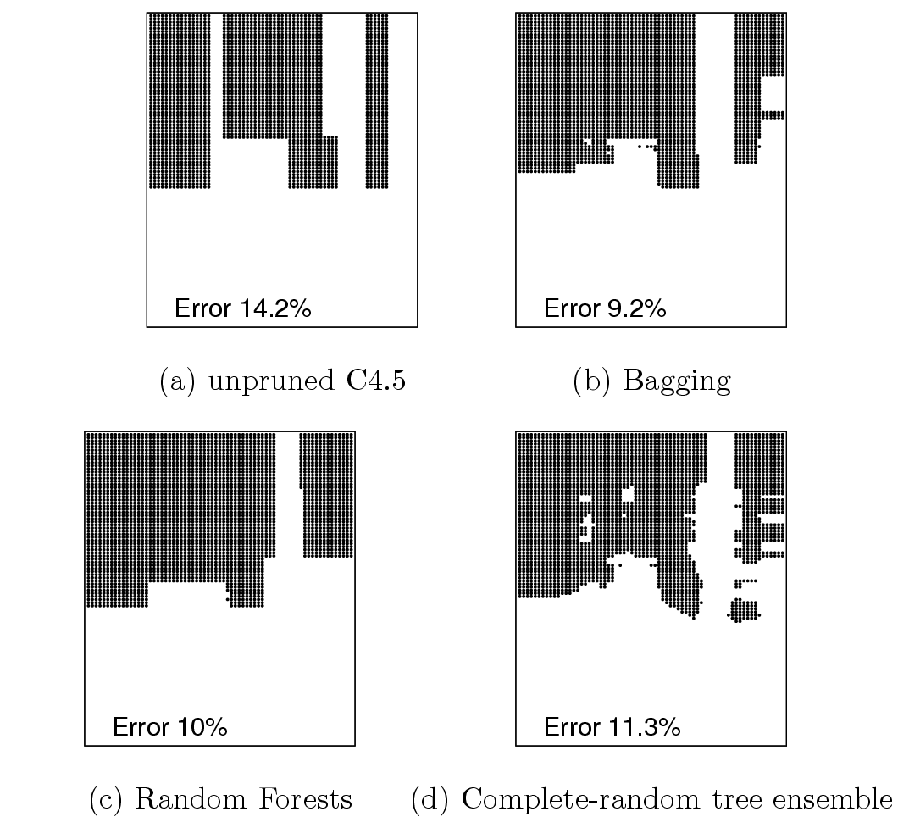
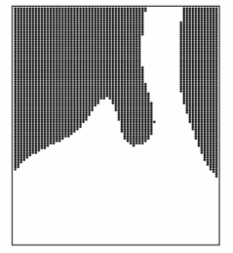
RDT looks
like the optimal
boundary

Slide 44
Outline
An overview of ensemble methods
  Motivations
  Tutorial overview
Supervised ensemble
Unsupervised ensemble
Semi-supervised ensemble
  Multi-view learning
  Consensus maximization among supervised and unsupervised models
Applications
  Transfer learning, stream classification, anomaly detection

Slide 45
Clustering Ensemble
Problem
  Given an unlabeled data set D={x₁,x₂,…,x_{n}}
  An ensemble approach computes:
    A set of clustering solutions {C₁,C₂,…,C_{k}}, each of which maps data to a cluster: f_{j}(x)=m
    A unified clustering solutions f* which combines base clustering solutions by their consensus
Challenges
  The correspondence between the clusters in different clustering solutions is unknown
  Unsupervised
  Combinatorial optimization problem-NP-complete

Slide 46
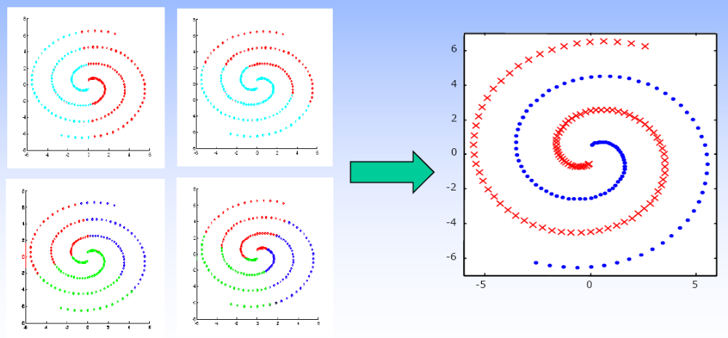
Motivations
Goal
  Combine “weak” clusterings to a better one
[PTJ05]

Slide 47
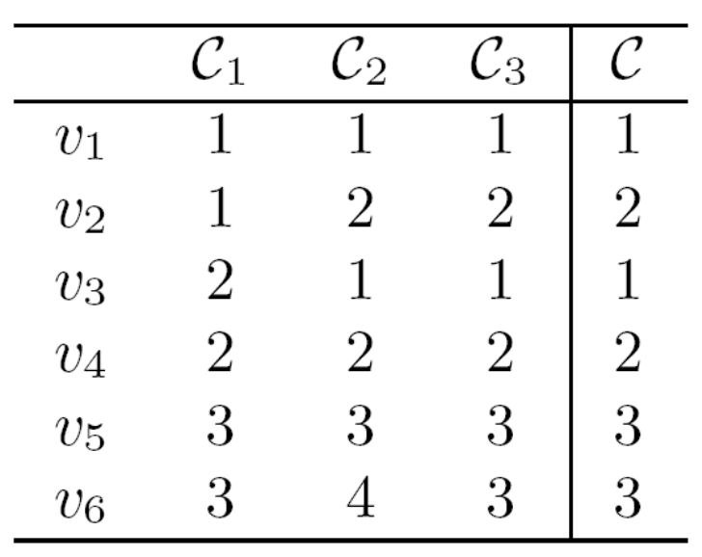
An Example
base clustering models
objects
they may not represent the same cluster!
The goal: get the consensus clustering
[GMT07]

Slide 48
Methods (1)
How to get base models?
  Bootstrap samples
  Different subsets of features
  Different clustering algorithms
  Random number of clusters
  Random initialization for K-means
  Incorporating random noises into cluster labels
  Varying the order of data in on-line methods such as BIRCH

Slide 49
Methods (2)
How to combine the models?
Correspondence
Explicit
Implicit
Generative
Approaches
Consensus
Function
Representation
Optimization
Method
Object-based
Cluster-based
Object-Cluster
-based

Slide 50
Hard Correspondence (1)
Re-labeling+voting
  Find the correspondence between the labels in the partitions and fuse the clusters with the same labels by voting [DuFr03,DWH01]
Re-labeling
Voting
 | C₁ | C₂ | C₃
v₁ | 1 | 3 | 2
v₂ | 1 | 3 | 2
v₃ | 2 | 1 | 2
v₄ | 2 | 1 | 3
v₅ | 3 | 2 | 1
v₆ | 3 | 2 | 1
 | C₁ | C₂ | C₃
v₁ | 1 | 1 | 1
v₂ | 1 | 1 | 1
v₃ | 2 | 2 | 1
v₄ | 2 | 2 | 2
v₅ | 3 | 3 | 3
v₆ | 3 | 3 | 3
C*
1
1
2
2
3
3

Slide 51
Hard Correspondence (2)
Details
  Hungarian method to match clusters in two different clustering solutions
  Match to a reference clustering or match in a pairwise manner
Problems
  In most cases, clusters do not have one-to-one correspondence

Slide 52
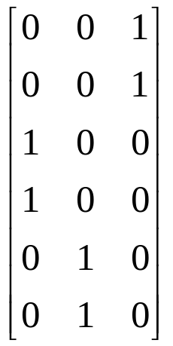
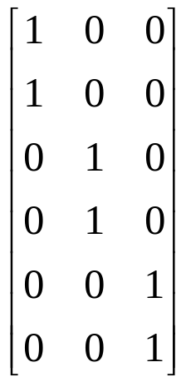
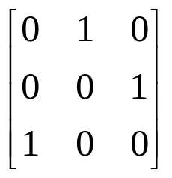
Soft Correspondence* (1)
Notations
  Membership matrix M₁, M₂, … ,M_{k}
  Membership matrix of consensus clustering M
  Correspondence matrix S₁, S₂, … ,S_{k}
  M_{i} S_{i} =M
 | C₁ | C₂ | C₃
v₁ | 1 | 3 | 2
v₂ | 1 | 3 | 2
v₃ | 2 | 1 | 2
v₄ | 2 | 1 | 3
v₅ | 3 | 2 | 1
v₆ | 3 | 2 | 1
M₂
S₂
M
X
=
*[LZY05]

Slide 53
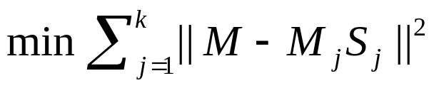
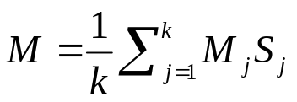
Soft Correspondence (2)
Consensus function
  Minimize disagreement
  Constraint 1: column-sparseness
  Constraint 2: each row sums up to 1
  Variables: M, S₁, S₂, … ,S_{k}
Optimization
  EM-based approach
  Iterate until convergence
    Update S using gradient descent
    Update M as

Slide 54
Conclusions
Ensemble
  Combining independent, diversified models improves accuracy
  No matter in supervised, unsupervised, or semi-supervised scenarios, ensemble methods have demonstrated their strengths
  Base models are combined by learning from labeled data or by their consensus
Beyond accuracy improvements
  Information explosion motivates multiple source learning
  Various learning packages available
  Combine the complementary predictive powers of multiple models
  Distributed computing, privacy-preserving applications

Slide 55
Thank You!
  Shangsong Liang
  Sun Yat-sen University
Notes:
Slides and more references available at http://ews.uiuc.edu/~jinggao3/sdm10ensemble.htm

